Slide 1
SYSTEM DEBBUGER

Slide 2

COMPANY PROFILE:-
EXCELLENCE TECHNOLOGY (ET) is India based leading strategic IT Company offering integrated IT solutions with the vision to provide Excellence in software solution. We at EXCELLENCE TECHNOLOGY bring innovative ideas and cutting edge technologies into business of customers. EXCELLENCE TECHNOLOGY is having rich experience in providing high technology end to end solutions in MOBILE APP AND WEB DEVELOPMENT.

Slide 3
During training we studied
HTML
CSS
JAVASCRIPT
PHP

Slide 4
About Project
Introduction
The expert intelligent system debugger is introduced to develop hardware fault detection for any computer system.
Different hardware system or electronics devices usually face application fault as well as hardware fault.
This application oriented formal reasoning applies to determine the problem in computer system.
The proposed system is meant to automate the maintenance, repair, and operations process, and free-up human technicians from manually performing routine, laborious, and time-consuming maintenance tasks.

Slide 5
Hardware Requirements
Pentium-IV(Processor).
256 MB Ram
512 KB Cache Memory
Hard disk 10 GB

Slide 6
Software Requirements
Operating System : Windows
Programming language: PHP
Front-End: HTML, PHP, j-query, Java script, CSS
Back-End: MYSQL
Web Server: WAMP Server

Slide 7
Front End
HTML
CSS
JAVASCRIPT
PHP
Back End
My SQL
WAMP Server

Slide 8
Modules we worked on
Login Module:
Customer can enter into the website by logging into the website. It contains two modules for login.
Add details :
User can add details by filling into registration form. User can upload the image.
Choose problem:
User can choose problem according to their system and can find solution.

Slide 9
Buy products:
Users can buy products and can review all the details of the product by read more reference.
Update account information:
User can update or change the user account details like as change the user name, change the password, change the email address.
Delete User:
We can delete the user detail or delete the user by going in to the registration table.

Slide 10
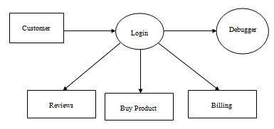
0 Level DFD

Slide 11
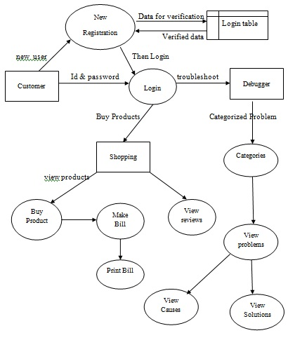
1 Level DFD

Slide 12
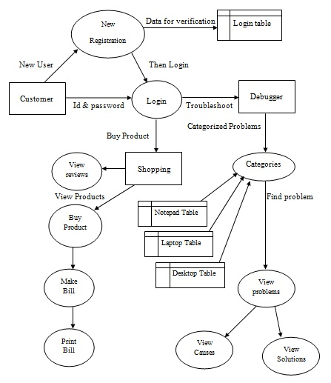
2 Level DFD

Slide 13
SNAPSHOTS

Slide 14
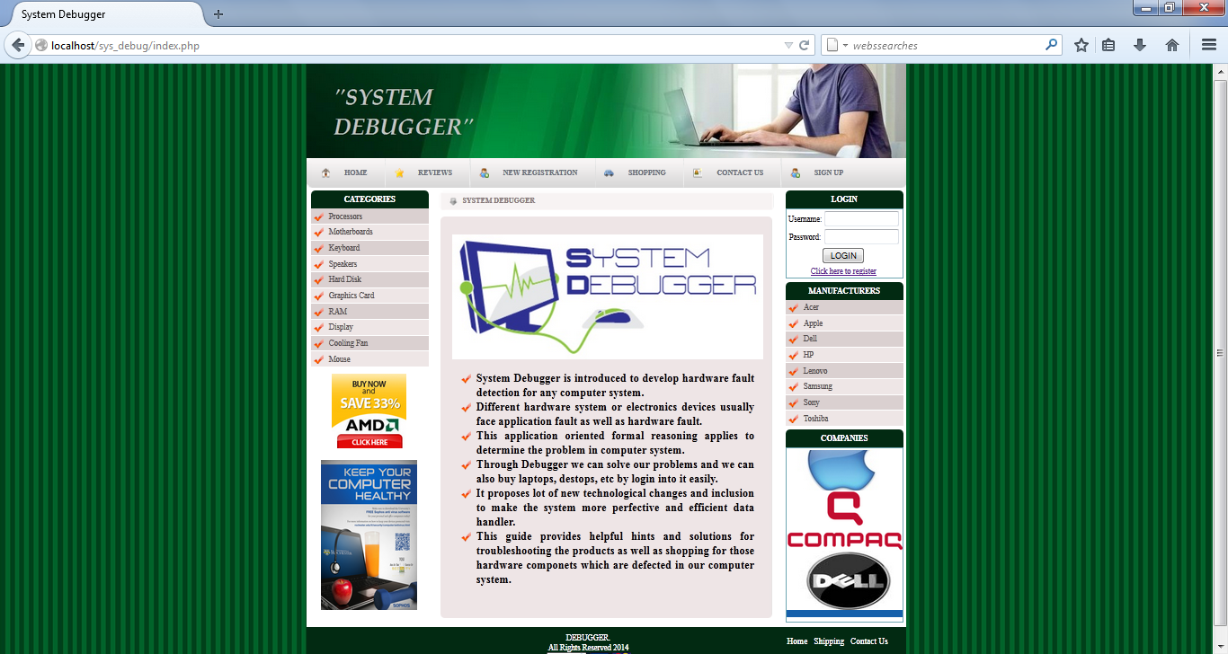
Home Page

Slide 15
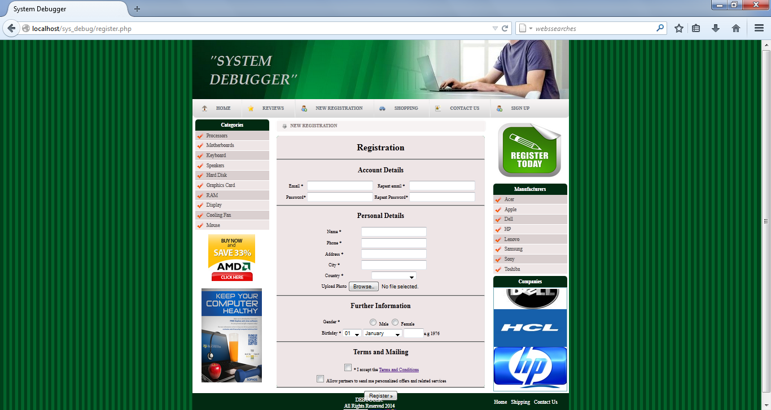
Registration Page

Slide 16
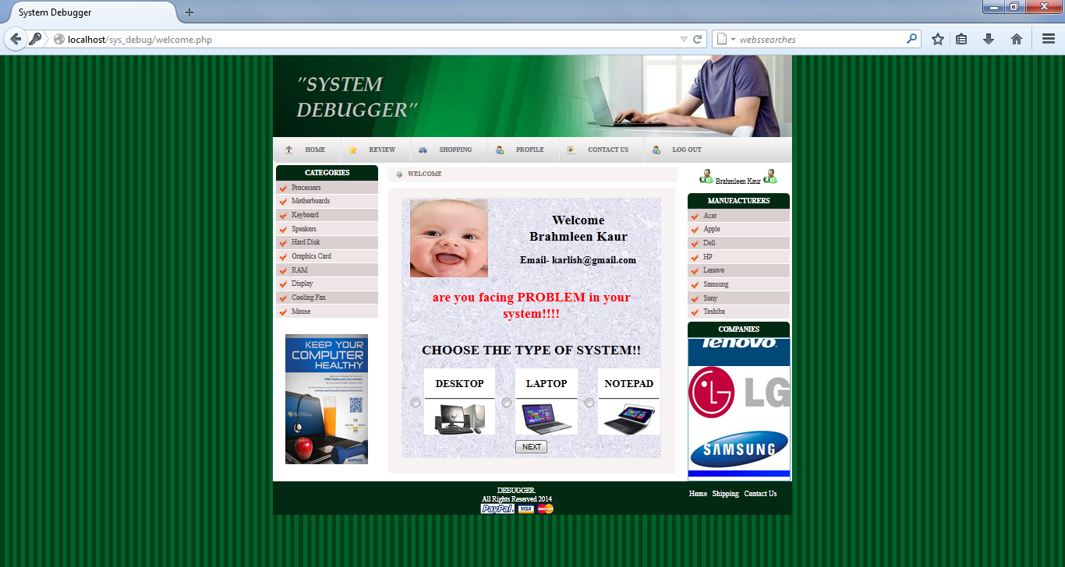
Welcome Page

Slide 17
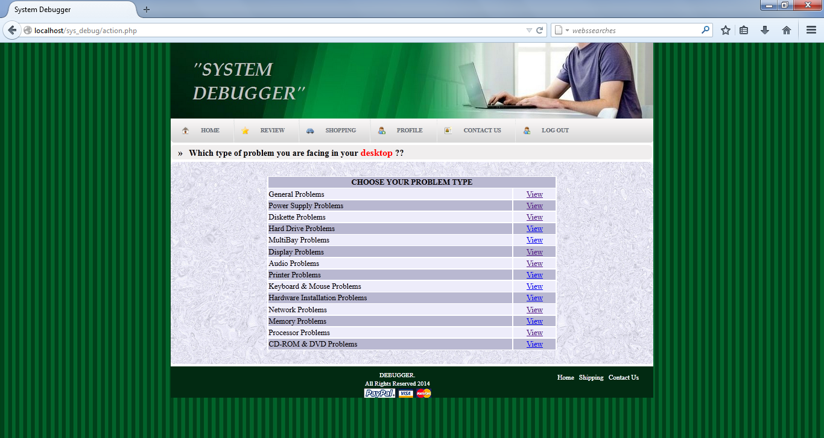
Categories Page

Slide 18
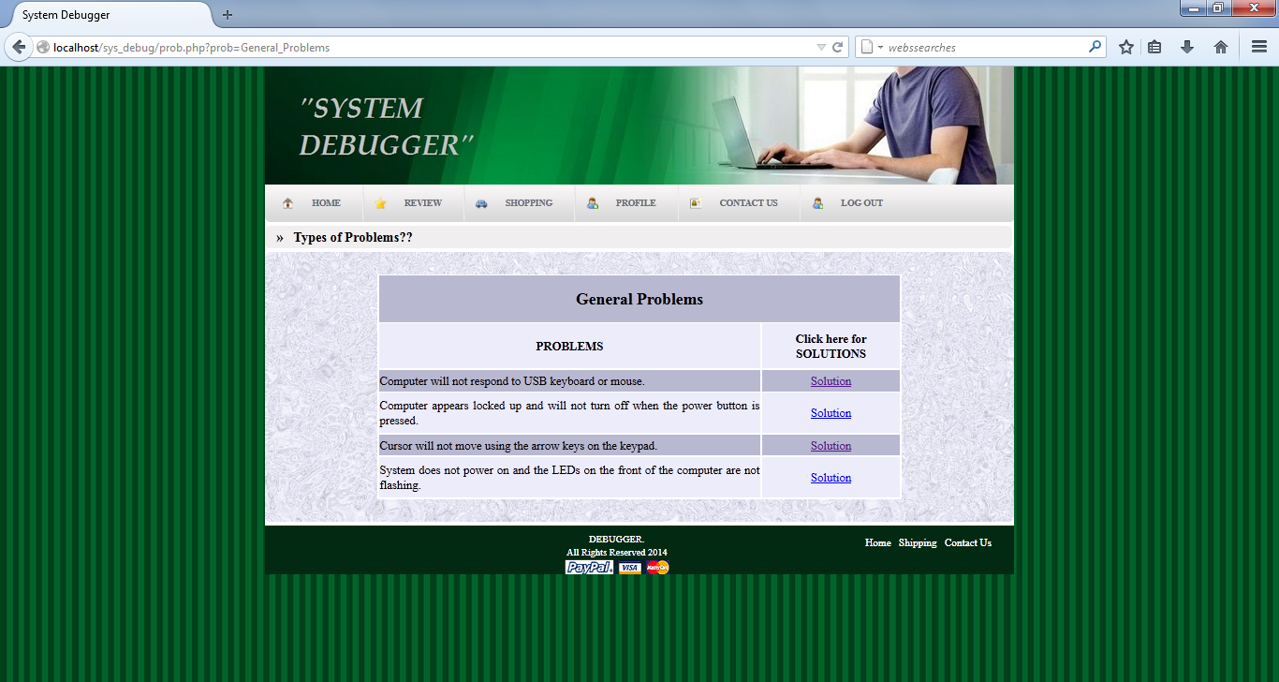
Problem Page

Slide 19
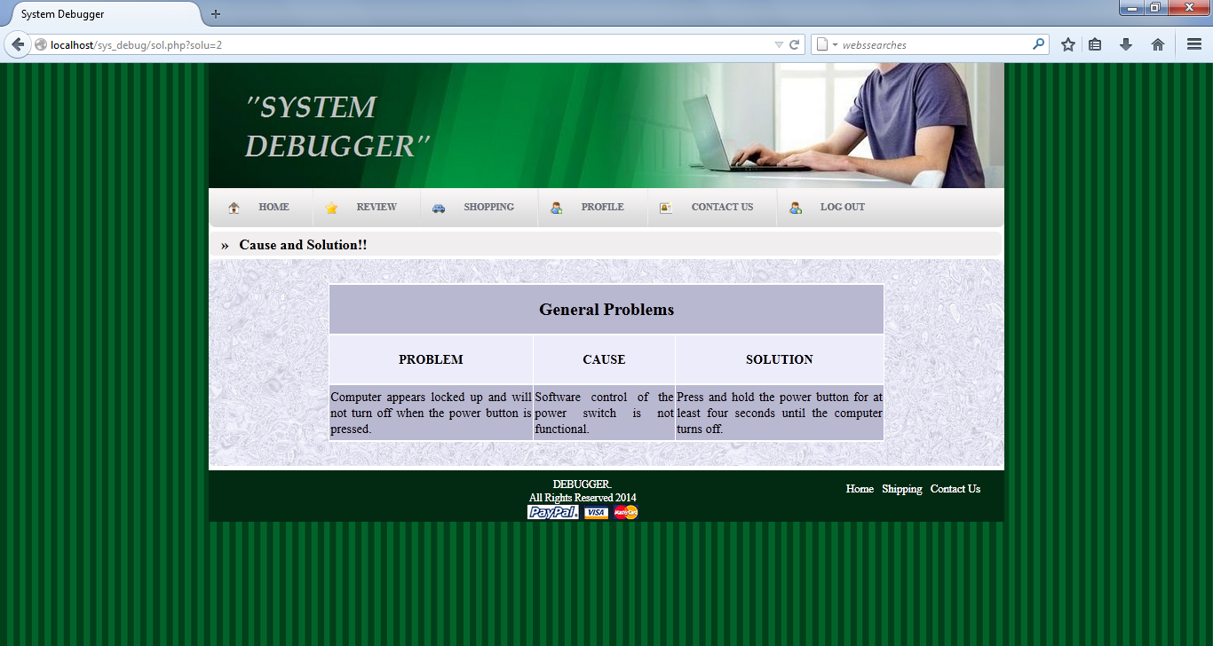
Solution Page

Slide 20
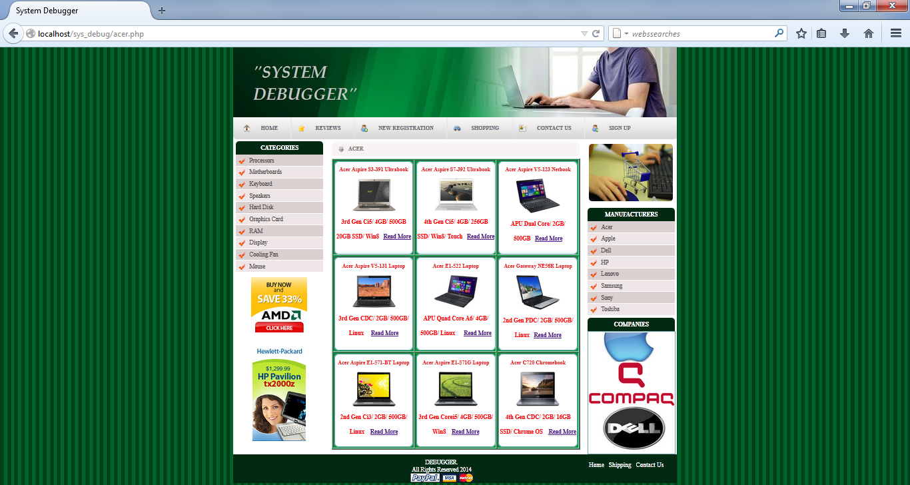
Product Page

Slide 21
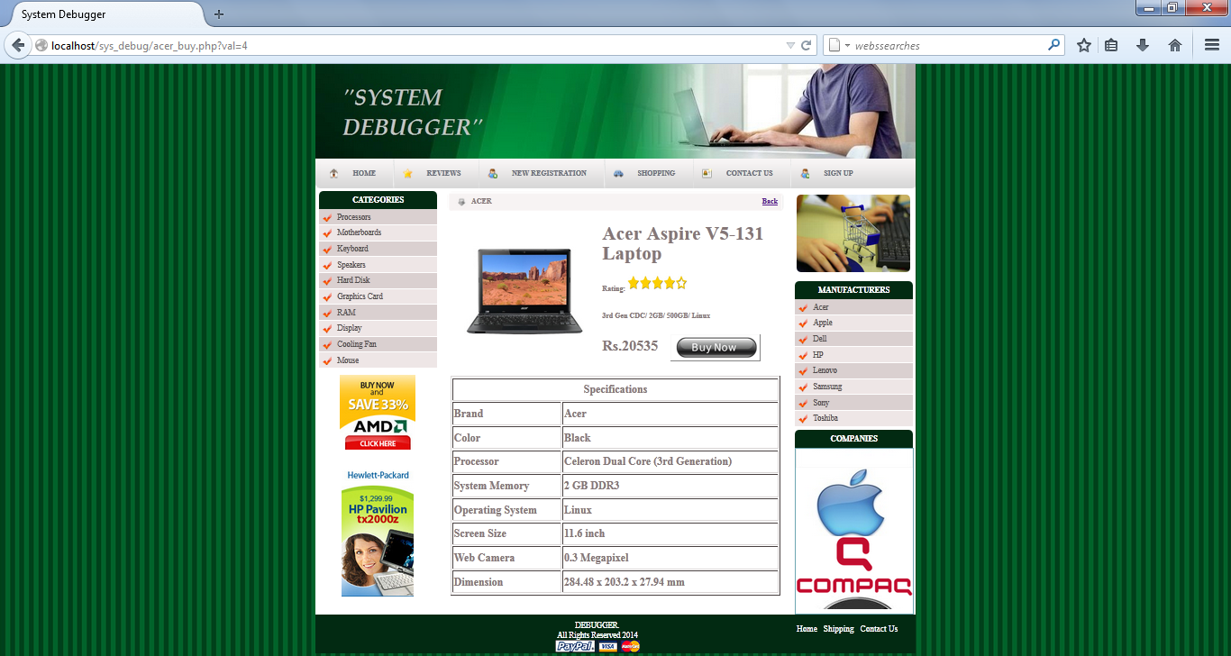
Product Detail Page

Slide 22
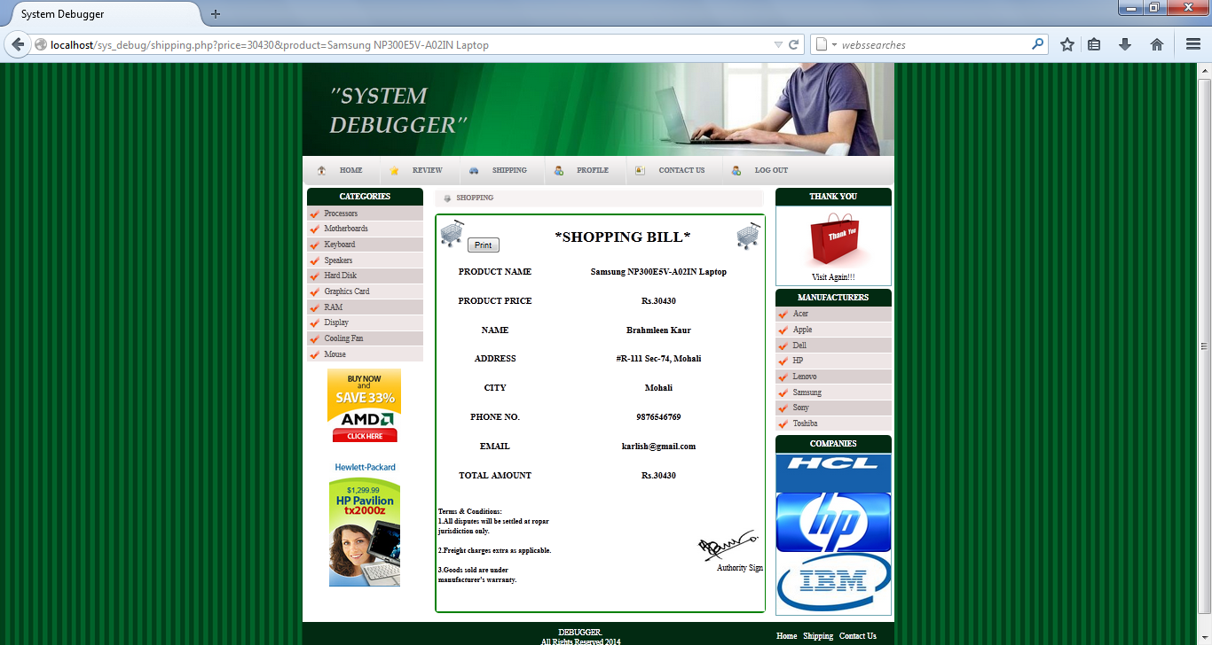
Billing Page

Slide 23
THANK YOU
SUBMITTED BY:
BRAHMLEEN KAUR(1188250)
GURPREET KAUR(1188252)

